Slide 1
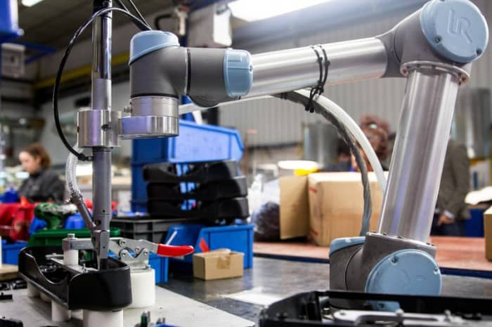

CSC485B Machine Learning for Robotics
SUNY Plattsburgh
Dr. Ned Lecky
Class 11- More on Classifiers, and Clustering

Slide 2
More Test Data Examples
Create data that is “really easy”
https://github.com/nedlecky/CSC485B/blob/main/CSC485_205_PartClassifierTest.ipynb
Four inputs
Three are identically random
One has the category “built in” in some obvious way
As itself
Or as some other int
Or the number is either 0, even, or odd per category
Or the number is either 2 digits, 3 digits, or 4 digits
What do we learn?

Slide 3
The Lesson?
Regression and Classification
Really only work if make sure our problem can be forced into simple math

Slide 4
But Don’t Give Up!
Solving 2% of the World’s Problems is a big accomplishment!
Ant the 8% that could be handled with a custom algorithm is low-hanging fruit
Just don’t spend too much time working on the other 90%!

Slide 5
How Is the Can OCR Going?
Let’s Check In!

Slide 6
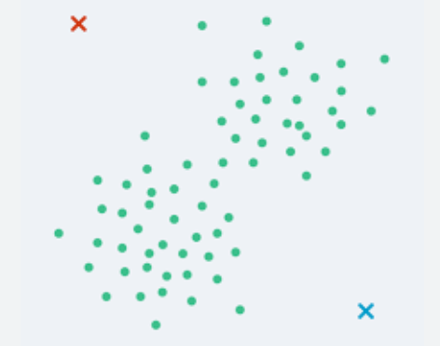
Clustering
We’ve been looking at Supervised Learning
Data provides example inputs with desired outputs
Can be used to train regression or classification models
How about unsupervised learning
Best example: clustering
At the left: One cluster? Two? Three?
AND: This is just 2-input data. Our algorithms will work with huge dimensions!

Slide 7
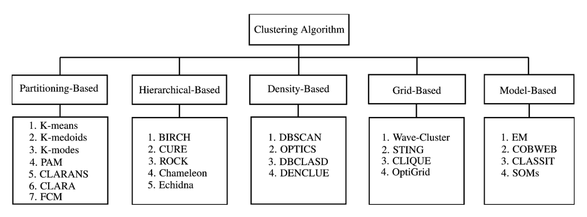
Lots of Hard-Core Computer Science
A Survey of Clustering Algorithms for Big Data: Taxonomy and Empirical Analysis
https://www.computer.org/csdl/journal/ec/2014/03/06832486/13rRUEgs2xB

Slide 8
Why Is Clustering so BIG?
Supervised learning is really more direct math, although
Training can be imprecise and heuristic which creates lots of variation (and academic papers)
Clustering and Unsupervised Learning is more heuristic
Methodologies and data analysis and trial-and-error
Fruitful area for many different approaches and techniques
No one “optimal” approach
The only way to know the best approach would be to know the answers!
The Beginners Guide to Clustering Algorithms and How to Apply Them in Python
https://cnvrg.io/clustering-algorithms/

Slide 9
A Walk Through Ch. 9 Geron
From our book
https://github.com/ageron/handson-ml3/blob/main/09_unsupervised_learning.ipynb
There’s a huge amount here but we can get a flavor

Slide 10
Next Assignment
Build your own real-world classification problem
Invent a (simple) problem
Generate synthetic data (or acquire something real)
Try different classifiers and adjust your data and approach until you are successful
Build your own real-world clustering problem
Invent a (simple) problem
Generate synthetic data (or acquire something real)
Try different clustering algorithms and adjust your data and approach until you are successful

Slide 11
Ideas
Remember my pie chart and try to pick something that you believe will work
Picking your problem and generating or collecting your data is the bulk of the work here… the rest is using mostly off-the-shelf code!
If you use images, keep them small and low-res or you will fall into a deep hole
Classification Ideas
Words, language Identification, weather, …
Try to classify test and training data
Clustering Ideas
Look at measurements, scores, weather data
Try to find clusters of results

